Slide 1


DEPARTMENT OF ELECTRICAL AND ELECTRONICS ENGINEERING BIRLA INSTITUTE OF TECHNOLOGY, MESRA
EEESOC SPP
PREDICTION OF STOCK MARKET USING MACHINE LEARNING ALONG WITH DATABASE SYSTEMS
PRESENTED BY : DEVANSH BALDWA
BTECH/10492/18
SUPERVISED BY:
RUDRA KUMAR

Slide 2
CONTENTS
MOTIVATION
OBJECTIVE
WORK DONE
APPLICATIONS AND FUTURE SCOPE
RESULTS AND CONCLUSIONS
REFERENCES

Slide 3
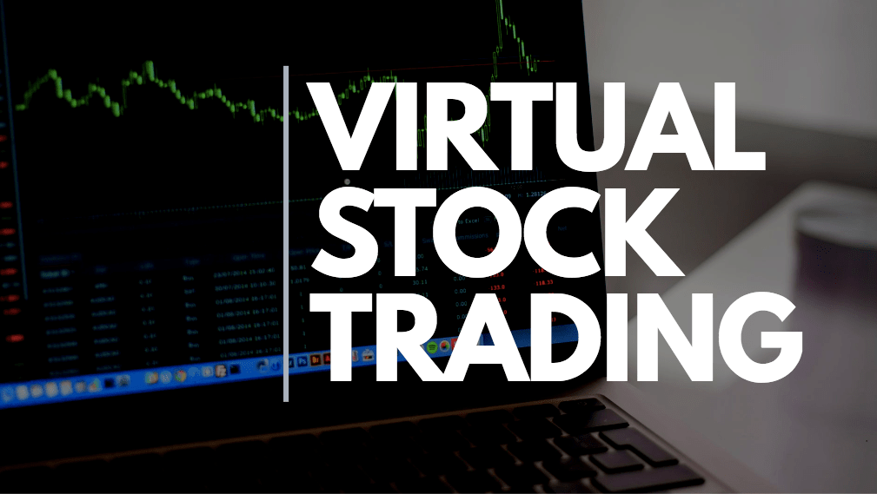

MOTIVATION :
I bought my first stock at the age of 14 with the help of my uncle. Since then I am interested in knowing and learning more about the Stock Market.
Also, I participated in VSS (Virtual Stock Simulation), which was a competition conducted by EDC BIT Mesra, and I want to explore the field furthermore and try to combine technology into it.
There are many companies which are in this field and looking forward to develop technologies like this. Few examples are Zerodha, Charles Schwab, Fidelity Investments, etc.

Slide 4
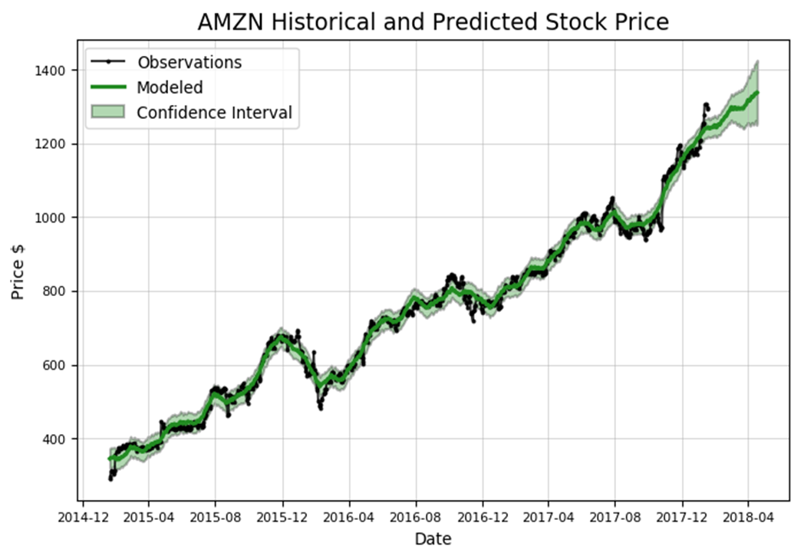
OBJECTIVE :
The objective of this project is to use Machine Learning to predict the Stock Market. Along with ML, Database Systems in MySQL(since we need to store in tabular form) are used which help us manage the records and information about the stocks. These two are combined to make a very useful product.

Slide 5
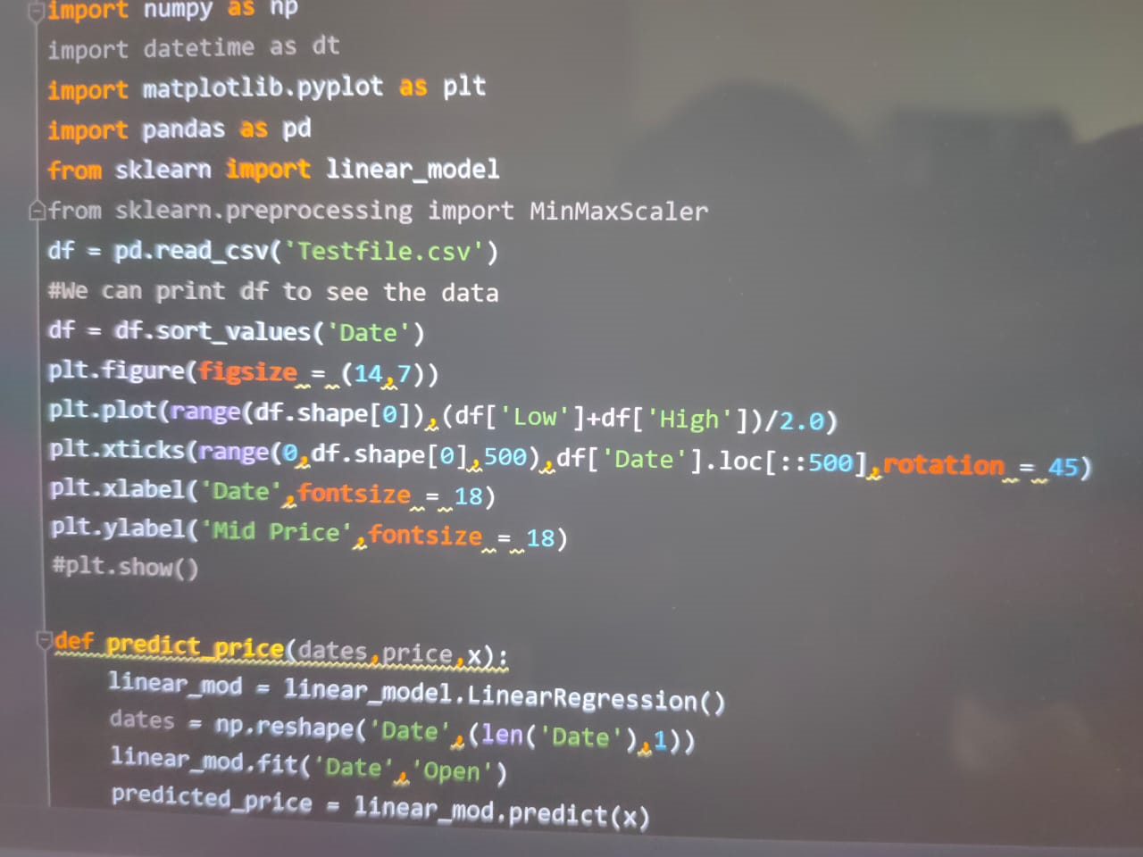
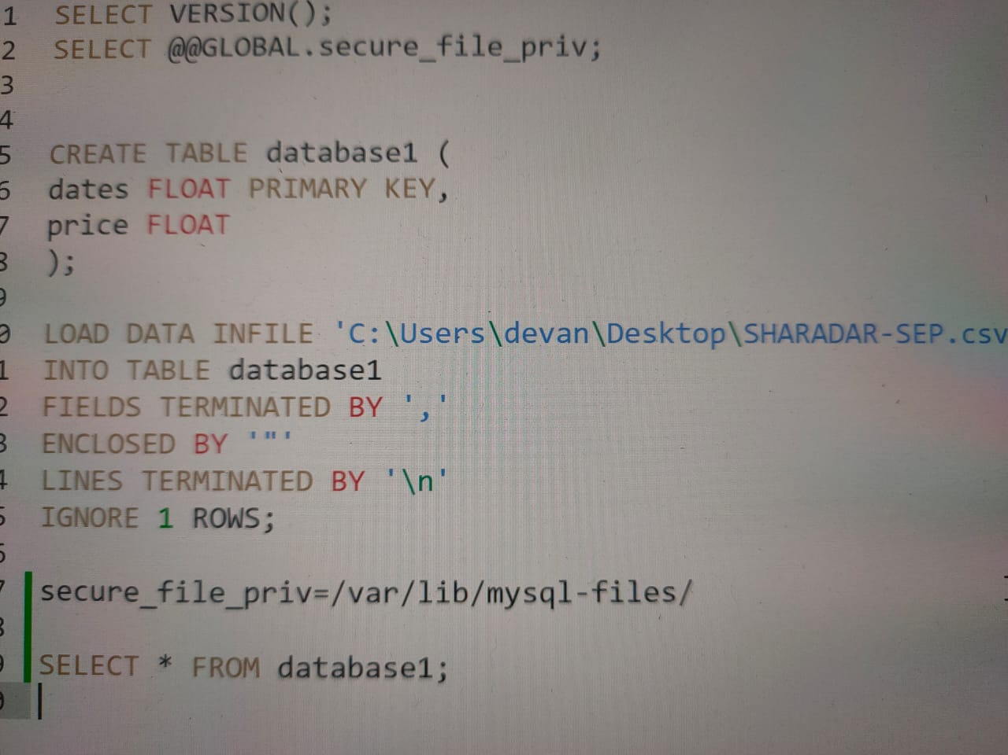
WORK DONE :
Code on Python was written and data which was taken as input was downloaded from the site Quandl. Then the input data was run and the stock prices were predicted.
Then the predicted prices were noted in MySQL which is a Database Management System which will help to keep a track of all the stock predictions of the stocks we are interested in.

Slide 6
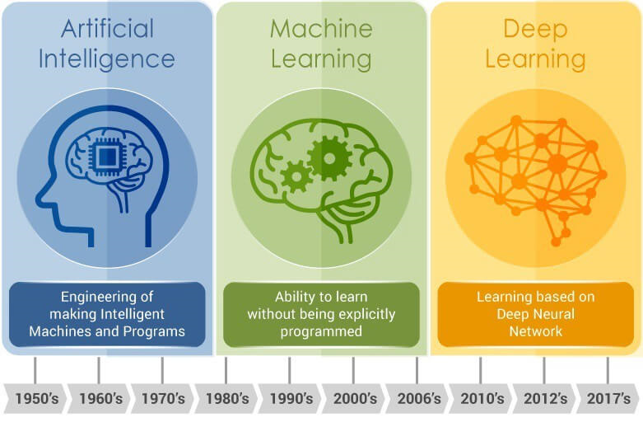

APPLICATIONS & FUTURE SCOPE :
Predictive models for Stock Market are being used presently but they can definitely be improved by using Deep Learning, AI and other technologies for precise results.
Projects like these are very useful for huge FinTech Companies which use ML, Deep Learning & AI to store, preserve and protect the data of their consumers. Examples of such companies are PayTm, MasterCard, etc.

Slide 7
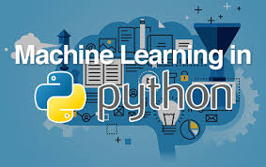
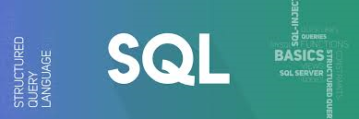
RESULTS & CONCLUSIONS :
The prediction using this project is not always true, but the price of the stock is predicted upto a certain extent and the data is linked to a tabular database.
Therefore, we used Machine Learning using predictive models and modules in Python like Numpy, Pandas, Sklearn, Matplotlib, etc. to predict the value of a stock. We also used Database System in MySQL to store information about our stock and it’s predicted value.

Slide 8



REFERENCES :
References for this project were taken from:
1) YouTube Videos by Siraj Raval
2) For Python –
https://jerry-git.github.io/learnpython3
3) Online blogs on Quora
4) Theory from –
https://w3schools.com

Slide 9


